Slide 1
UC Berkeley’s CS61A – Lecture 10 – Tree Recursion
Trump's Plan to Keep America First in AI www.wired.com/story/trumps-plan-keep-america-first-ai
“Donald Trump today will sign an executive order for the federal government to channel existing funds, programs, and data in support of artificial intelligence (AI) research and commercialization. The American AI Initiative will ask agencies to assist U.S. workers' adjustment to professions impacted by AI by supporting training and fellowships, and to consider what new regulations may be needed to rein in unwelcome effects. The program also would ask certain agencies in areas like health and transportation to open data stores to academics and companies engaged in AI research, using privacy-protecting mechanisms. UW’s Ryan Calo said the initiative's progress should reveal whether the White House is seriously considering related ethical and human rights issues, like whether "they [are] aware enough of [AI's] social impacts, and thinking about the effects on society and how to address the problems it creates."”

Slide 2
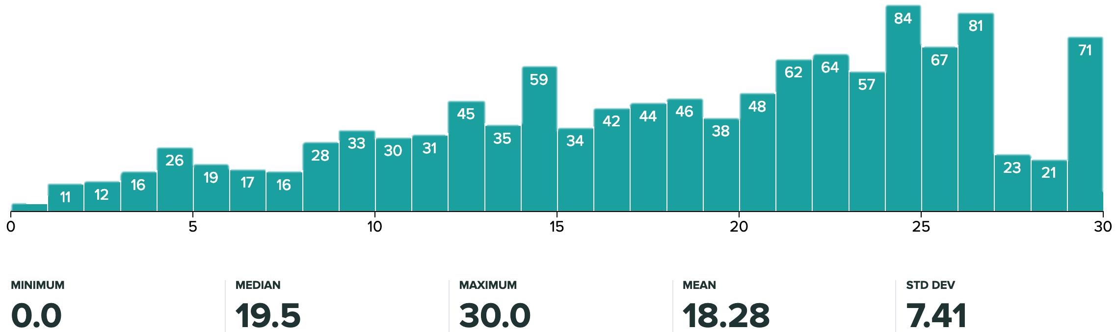
Announcements
Midterm 1 Results out, thoughts?
Midterm 1
Please review rubrics+solutions before submitting regrade request, on gradescope, due Wed, Feb 13th 11pm
The add / drop deadline is today, Wed, Feb 13th
It is still possible to swap to CS 10; however, you’ll make up the work, email cs10@berkeley.edu
CS Mentors Sections
Small sections designed to help you get more individual attention
If you want a unit for a CSM section must be done by Wed, Feb 13th (add / drop deadline)
Note: you don't have to sign up for a unit to get a section
Doctests are just samples of how it runs, they’re often not the exhaustive tests!
Hog Contest released, due 2/22! Fame for being chosen among Hog Winners!!

Slide 3
Order of Recursive Calls

Slide 4
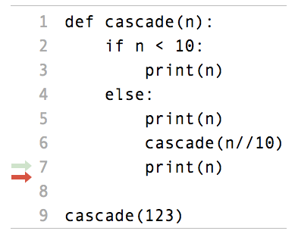
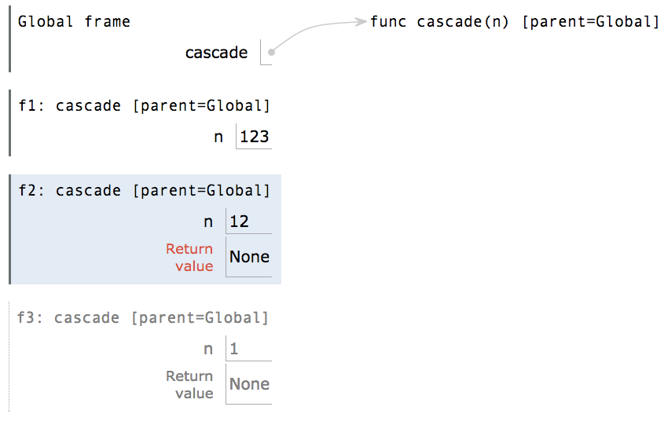
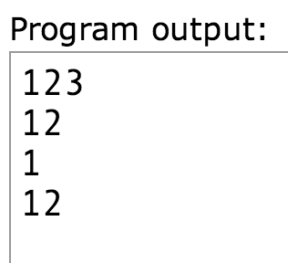
The Cascade Function
(OPT Demo)
Each cascade frame is from a different call to cascade.
Until the Return value appears, that call has not completed.
Any statement can appear before or after the recursive call.
http://pythontutor.com/composingprograms.html#code=def%20cascade%28n%29%3A%20%20%20%20%0A%20%20%20%20if%20n%20%3C%2010%3A%20%20%20%20%20%20%20%20%0A%20%20%20%20%20%20%20%20print%28n%29%20%20%20%20%0A%20%20%20%20else%3A%20%20%20%20%20%20%20%20%0A%20%20%20%20%20%20%20%20print%28n%29%20%20%20%20%20%20%20%20%0A%20%20%20%20%20%20%20%20cascade%28n//10%29%20%20%20%20%20%20%20%20%0A%20%20%20%20%20%20%20%20print%28n%29%20%20%20%20%20%20%20%20%0A%20%20%20%20%20%20%20%20%0Acascade%28123%29&cumulative=true&curInstr=0&mode=display&origin=composingprograms.js&py=3&rawInputLstJSON=%5B%5D

Slide 5
Two Definitions of Cascade
(Demo, clean up cascade)
def cascade(n):
if n < 10:
print(n)
else:
print(n)
cascade(n//10)
print(n)
def cascade(n):
print(n)
if n >= 10:
cascade(n//10)
print(n)
If two implementations are equally clear, then shorter is usually better
In this case, the longer implementation is more clear (at least to me)
When learning to write recursive functions, put the base cases first
Both are recursive functions, even though only the first has typical structure

Slide 6
Example: Inverse Cascade

Slide 7
Inverse Cascade
Write a function that prints an inverse cascade:
1 12 123 1234 123 12 1
1 12 123 1234 123 12 1
def inverse_cascade(n):
grow(n)
print(n)
shrink(n)
def f_then_g(f, g, n):
if n:
f(n)
g(n)
grow = lambda n: f_then_g(grow, print, n//10)
shrink = lambda n: f_then_g(print, shrink, n//10)

Slide 8
Tree Recursion

Slide 9
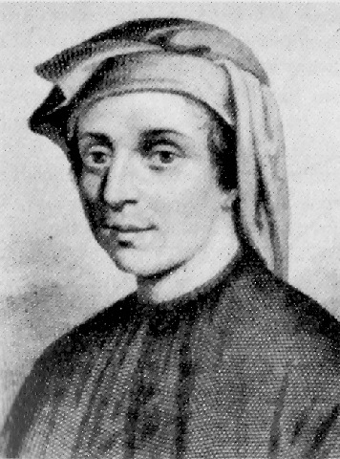
Tree Recursion
Tree-shaped processes arise whenever executing the body of a recursive function makes more than one recursive call
n:
0, 1, 2, 3, 4, 5, 6, 7, 8,
... , 35
fib(n):
0, 1, 1, 2, 3, 5, 8, 13, 21,
... , 9,227,465
def fib(n):
if n == 0:
return 0
elif n == 1:
return 1
else:
return fib(n-2) + fib(n-1)
http://en.wikipedia.org/wiki/File:Fibonacci.jpg

Slide 10
A Tree-Recursive Process
The computational process of fib evolves into a tree structure
fib(5)
fib(3)
fib(4)
fib(1)
fib(2)
fib(2)
fib(3)
1
fib(0)
fib(1)
fib(0)
fib(1)
fib(1)
fib(2)
0
1
0
1
1
fib(0)
fib(1)
(Demo3)
0
1

Slide 11
Repetition in Tree-Recursive Computation
This process is highly repetitive; fib is called on the same argument multiple times
fib(5)
fib(3)
fib(4)
fib(1)
fib(2)
fib(2)
fib(3)
1
fib(0)
fib(1)
fib(0)
fib(1)
fib(1)
fib(2)
0
1
0
1
1
fib(0)
fib(1)
0
1
(We will speed up this computation dramatically in a few weeks by remembering results)

Slide 12
Example: Counting Partitions

Slide 13
Counting Partitions
The number of partitions of a positive integer n, using parts up to size m, is the number of ways in which n can be expressed as the sum of positive integer parts up to m in increasing order.
count_partitions(6, 4)
2 + 4 = 6
1 + 1 + 4 = 6
3 + 3 = 6
1 + 2 + 3 = 6
1 + 1 + 1 + 3 = 6
2 + 2 + 2 = 6
1 + 1 + 2 + 2 = 6
1 + 1 + 1 + 1 + 2 = 6
1 + 1 + 1 + 1 + 1 + 1 = 6

Slide 14
Counting Partitions
The number of partitions of a positive integer n, using parts up to size m, is the number of ways in which n can be expressed as the sum of positive integer parts up to m in non-decreasing order.
count_partitions(6, 4)
Recursive decomposition: finding simpler instances of the problem.
Explore two possibilities:
Use at least one 4
Don't use any 4
Solve two simpler problems:
count_partitions(2, 4)
count_partitions(6, 3)
Tree recursion often involves exploring different choices.

Slide 15
Counting Partitions
The number of partitions of a positive integer n, using parts up to size m, is the number of ways in which n can be expressed as the sum of positive integer parts up to m in increasing order.
Recursive decomposition: finding simpler instances of the problem.
Explore two possibilities:
Use at least one 4
Don't use any 4
Solve two simpler problems:
count_partitions(2, 4)
count_partitions(6, 3)
Tree recursion often involves exploring different choices.
def count_partitions(n, m):
if n == 0:
return 1
elif n < 0:
return 0
elif m == 0:
return 0
else:
with_m = count_partitions(n-m, m)
without_m = count_partitions(n, m-1)
return with_m + without_m
(Demo)
pythontutor.com/composingprograms.html#code=def%20count_partitions%28n,%20m%29%3A%0A%20%20%20%20if%20n%20%3D%3D%200%3A%0A%20%20%20%20%20%20%20%20return%201%0A%20%20%20%20elif%20n%20<%200%3A%0A%20%20%20%20%20%20%20%20return%200%0A%20%20%20%20elif%20m%20%3D%3D%200%3A%0A%20%20%20%20%20%20%20%20return%200%0A%20%20%20%20else%3A%0A%20%20%20%20%20%20%20%20with_m%20%3D%20count_partitions%28n-m,%20m%29%20%0A%20%20%20%20%20%20%20%20without_m%20%3D%20count_partitions%28n,%20m-1%29%0A%20%20%20%20%20%20%20%20return%20with_m%20%2B%20without_m%0A%20%20%20%20%20%20%20%20%0Aresult%20%3D%20count_partitions%285,%203%29%0A%0A#%201%20%2B%201%20%2B%201%20%2B%201%20%2B%201%20%3D%205%0A#%201%20%2B%201%20%2B%201%20%2B%202%20%2B%20%20%20%3D%205%0A#%201%20%2B%202%20%2B%202%20%2B%20%20%20%20%20%20%20%3D%205%0A#%201%20%2B%201%20%2B%203%20%2B%20%20%20%20%20%20%20%3D%205%0A#%202%20%2B%203%20%2B%20%20%20%20%20%20%20%20%20%20%20%3D%205&mode=display&origin=composingprograms.js&cumulative=false&py=3&rawInputLstJSON=[]&curInstr=0

Slide 16
Sierpinski Triangle
(1, 1)
(1/2, sqrt(3)/2)
(1/4, sqrt(3)/4)
(0, 0)
(1/2, 0)

